Slide 1
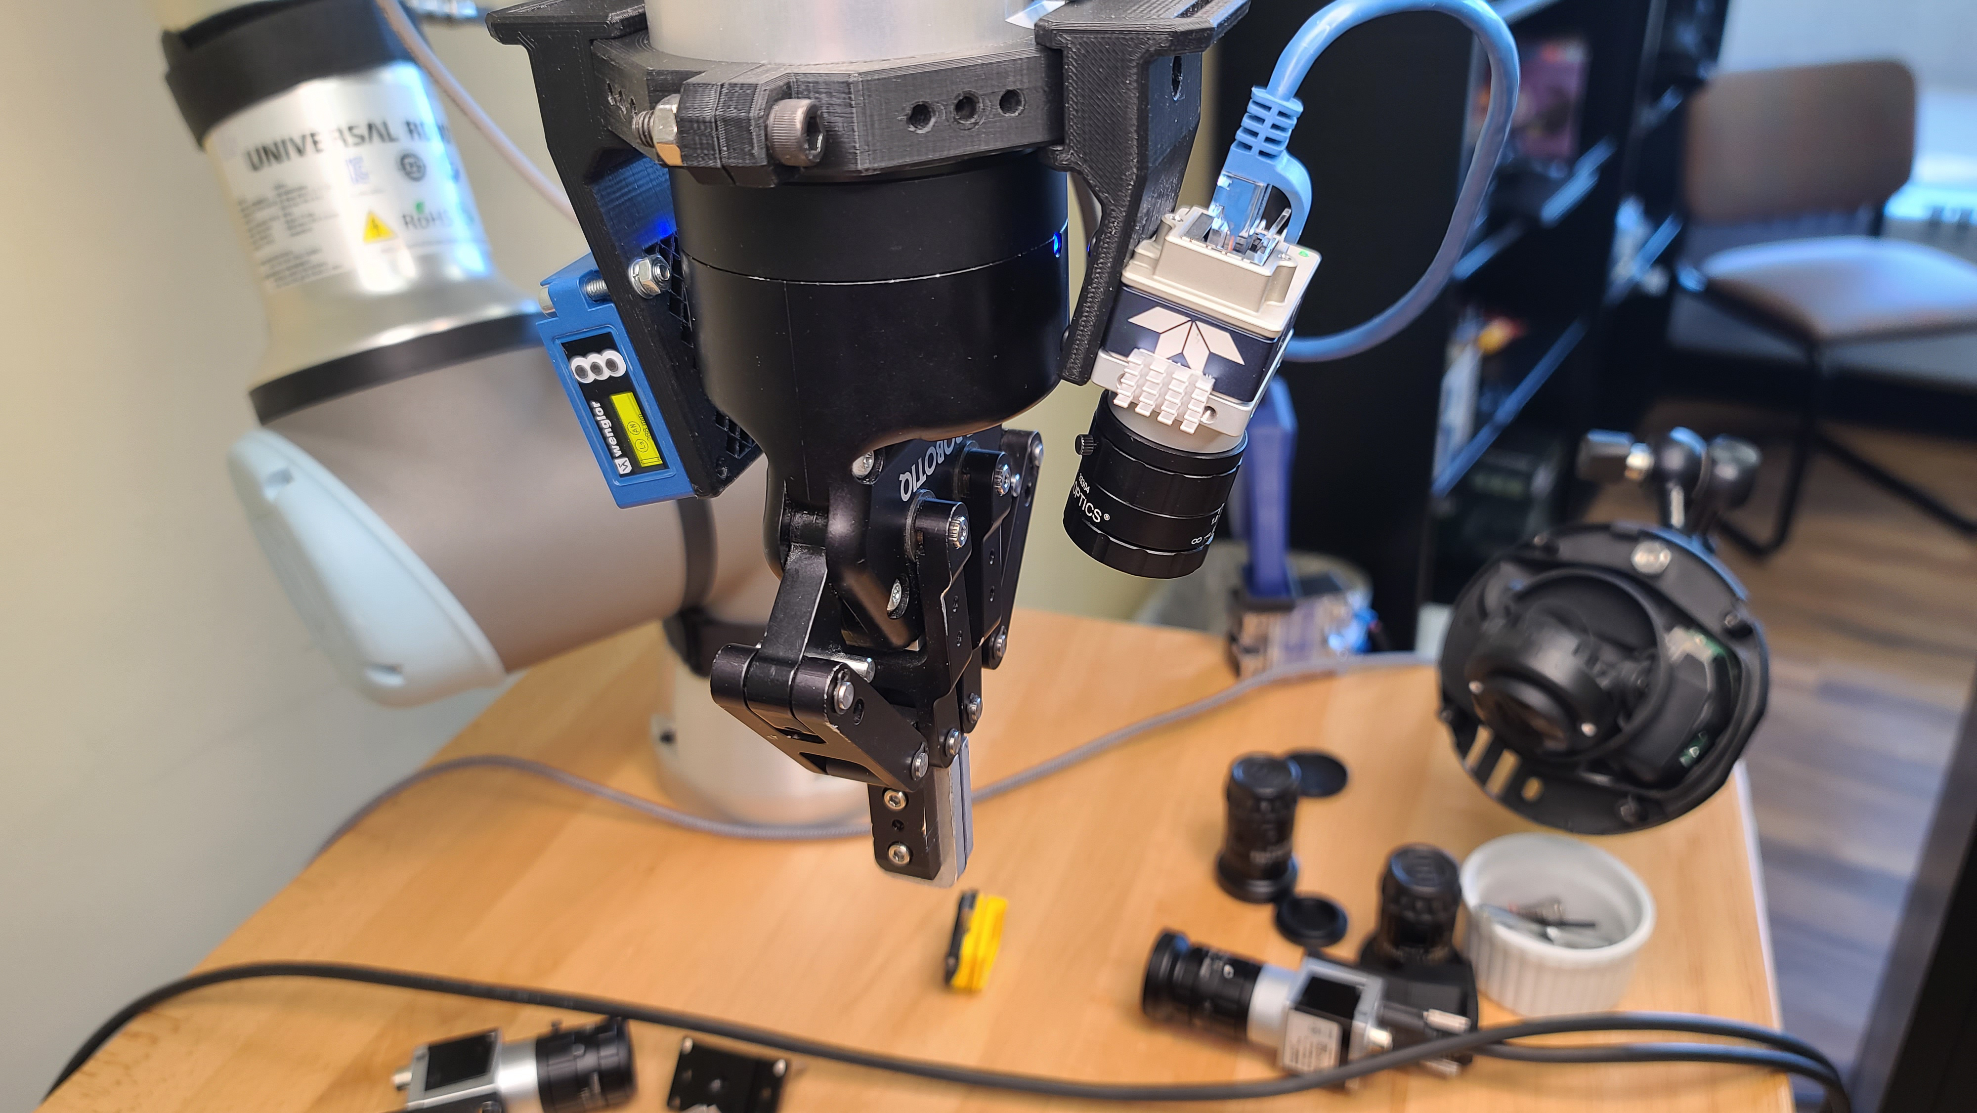

CSC485B Machine Learning for Robotics
SUNY Plattsburgh
Dr. Ned Lecky
Class 07- Getting Started with Vision

Slide 2
Robots and Vision
Most industrial grade cameras interface with GigE (or 5GigE or 10GigE)
Major Vendors
Basler https://www.baslerweb.com/en/products/cameras/
DALSA https://www.teledynedalsa.com/en/products/imaging/cameras/
Endless Distributors
https://www.edmundoptics.com/c/products/0/
https://www.phase1vision.com/cameras

Slide 3
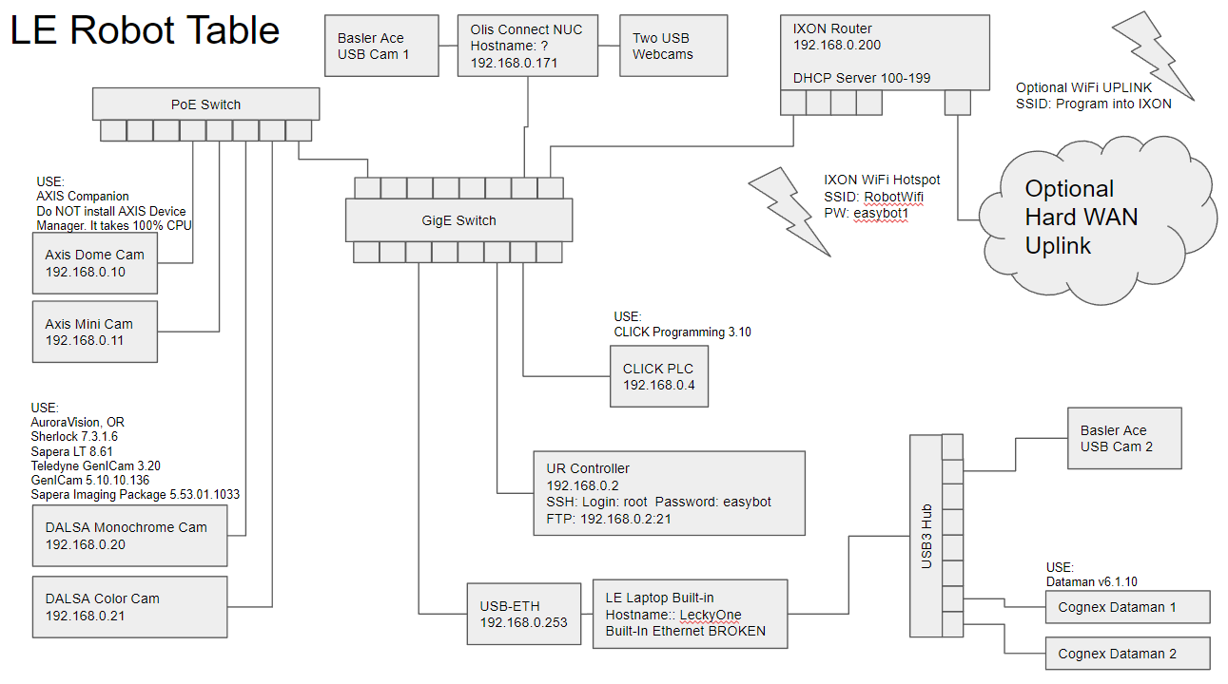
Network
My demo setup allows for USB3 or GigE, but for high performance you’d want multiple GigE interfaces

Slide 4
One Camera Per Interface
This is ideal
Many COTS IPCs provide this
COTS: Commercial Off-the-shelf
IPC: Industrial PC
OnLogic https://www.onlogic.com/computers/rugged/?lan_port_filter=1368
But… we can often get away with a few low-res cameras on one interface, especially for testing
Ex- 4MP Monochrome 8b at 20 fps is 4MB x 8b/B x 20 per second is 640Mbps
Latency is 4MB * 8b/B / 1Gbps = 32mS
Might or might not be OK for you DOTA (Depending on the application)

Slide 5
Lighting and Optics
Robotics- you sort of need to learn about everything!
This one is really a complete course in itself
AIA Ce3rtified Vision Professional courses
https://www.automate.org/a3-content/certified-vision-professional
A pretty comprehensive-ish overview from National Instruments
https://www.ni.com/en-us/innovations/white-papers/12/a-practical-guide-to-machine-vision-lighting.html

Slide 6
Robot Setup
We have a camera and a laser distance sensor on the bot now
We can use TCPs to put all of them at the same spot for different setups
Demo: 485visionBaseline.urp

Slide 7
Demo with the DALSA Nano
Some basics
Focal Length
Aperture
Depth of Focus
Exposure time
Let’s try to adjust depth of focus using aperture and shutter speed
And maybe read a barcode or do a pattern match…
Easy software (not free) is Sherlock
https://www.teledynedalsa.com/en/products/imaging/vision-software/sherlock/
Written by yours truly in the 1990s, still sold today by Teledyne DALSA (who have dramatically improved and expanded it!)
Why not use OpenCV? It doesn’t have this integration interface.
(Maybe we should write one!)

Slide 8
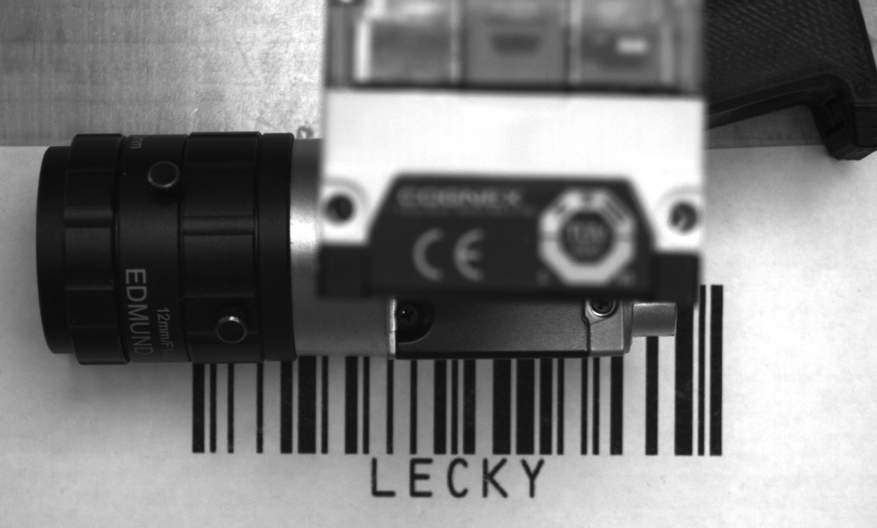
Can we get both in focus?
Photography is a useful hobby in robotics!
https://www.exposureguide.com/focusing-basics/

Slide 9
And in Motion?
Let’s run the robot and see how we do
485viisonCamUpDown.urp
Good enough for some machine vision?
Let’s try to read the barcode with Sherlock
And maybe some pattern finding

Slide 10
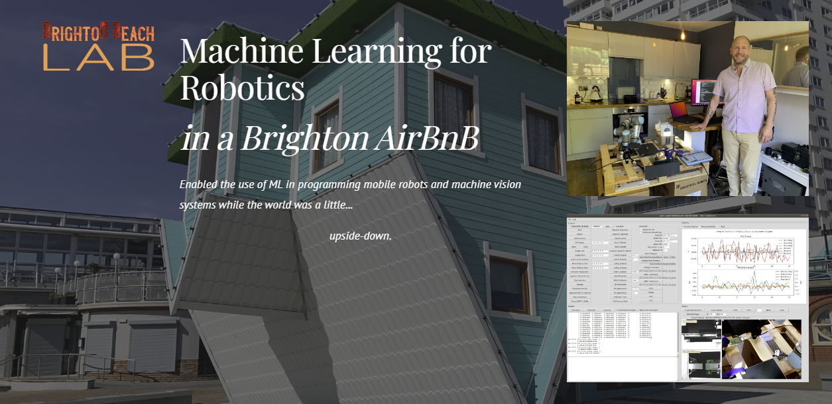
So where’s the ML?
What could ML help us with here?
An Intro to Brighton Beach Lab

Slide 11
What Was Brighton Beach Lab?
A more complex example from my time at Google and DeepMind
Brighton Beach Lab
https://sites.google.com/lecky.com/brighton-beach-lab/home

